Slide 1
Object-Oriented Design
Mimi Opkins
CECS274

Slide 2
OO Design
OO Design involves:
Discovering classes
Describing the relationships between classes
Determining the responsibilities of each class
UML diagrams can help us complete these tasks

Slide 3
Discovering Classes
We’ve already looked at what constitutes a good class
Sometimes the problem domain is new or unfamiliar to the software developers
In this case it can be difficult to discover classes
One technique that can be used is to look for nouns and noun phrases in the requirements description
Identify the words and phrases that denote things
Keep a list of candidate classes
Put all ideas for classes on the list
Ones that turn out to be not useful can be deleted later

Slide 4
Example: University Library System Books and journals
The library contains books and journals.
It may have several copies of a given book.
Some of the books are for short term loans only.
All other books may be borrowed by any library member for three weeks.
Members of the library can normally borrow up to six items at a time, but members of staff may borrow up to 12 items at one time.
Only members of staff may borrow journals.
New books and journals arrive regularly.
The current year’s journals are sent away to be bound into volumes at the end of each year.

Slide 5
Example: University Library System Borrowing
The system must keep track of when books and journals are borrowed and returned, enforcing the rules described above.

Slide 6
Suitability of Nouns
• Considering candidate classes in the singular form, discard any which are inappropriate for any reason:
– redundant, where the same class is given more than one name
– vague, where you can’t tell unambiguously what is meant by a noun
– an operation, where the noun refers to something which is done to, by or in the system
– meta-language, where the noun forms part of the way we define things

Slide 7
Suitability of Nouns
• Important characteristics to check for
– Retained information – potential classes require information (data) to be stored about them
– Multiple attributes – only a single attribute? Then this noun should probably serve as an attribute of some other class
– Common attributes: do all instances of this noun share the same attributes?

Slide 8
Nouns in the library system Discard:
– library, because it is outside of the scope of our system
– short term loan, because a loan is really an action, the lending of a book to a user – will reconsider this later
– member of the library, which is redundant: same as library member
– week, because it’s a measure of time, not a thing
– time, because it’s outside the scope of the system
– system, because it’s part of the meta-language of requirements description
– rule, for the same reason

Slide 9
Nouns in the library system Remaining:
– book
– journal
– copy (of book)
– library member
– member of staff
– volume
• Note, library member and member of staff are also users of the system
– represented in the system because data on these users will be maintained

Slide 10
Discovering Relationships
• Identify and name relationships or associations between classes
– Static relationship, independent of time
– Clarify understanding of the problem, by describing how objects work together
• For this task we can identify verbs in the requirements description as indicators of possible relationships
– A library member borrows/returns a copy
– A member of staff borrows/returns a copy
– A member of staff borrows/returns a journal
– A copy is a copy of a book
– A journal belongs to a volume

Slide 11
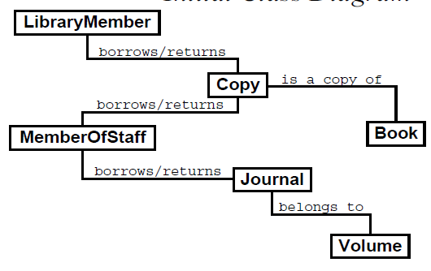
Initial Class Diagram

Slide 12

More on Associations
• Multiplicities
– An exact number – simply by writing it
– A range of numbers – using two dots between a pair of numbers
– An arbitrary, unspecified number – using ‘*’

Slide 13
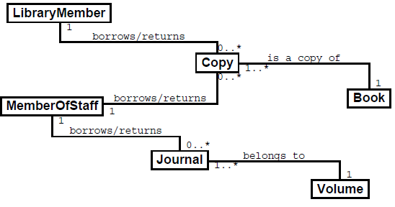
Updated Class Diagram

Slide 14
Association Classes
• We might wonder where the due date for a book should be stored
– Could store in the copy class and reset every time a book is borrowed
– However, might want to keep historical records of book/journal borrowing that links library members and books
• The borrows/returns association could have data associated with it, ie. a due date
– Treat the association as a class, hence the name “association class”
• Association classes are often used if there is a many-to-many association between two classes

Slide 15
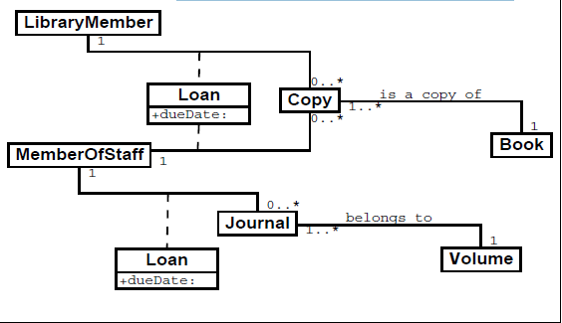
Updated Class Diagram

Slide 16
Generalization
• LibraryMember is a generalization of MemberOfStaff
– Conceptually every MemberOfStaff is a LibraryMember
– If part of the system works on LibraryMember, it ought to work on MemberOfStaff too
– On the other hand, there might be things that only make sense for MemberOfStaff (ex. Borrow journal). Therefore, MemberOfStaff is a special type of LibraryMember

Slide 17
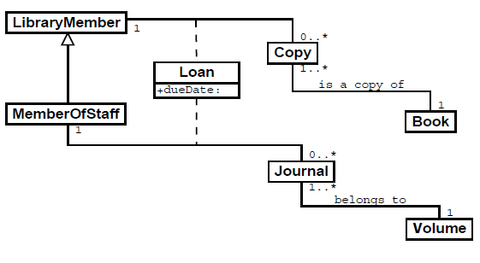
Revised Class Diagram

Slide 18
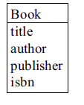
Attributes
• Describe data contained in an object of a class
– Shown in the second, middle compartment of the class icon
• Don’t show attributes that simply implement associations
– Ex. no ‘copies’ attribute in the ‘Book’ class
• Some nouns may become attributes of classes rather than classes themselves

Slide 19
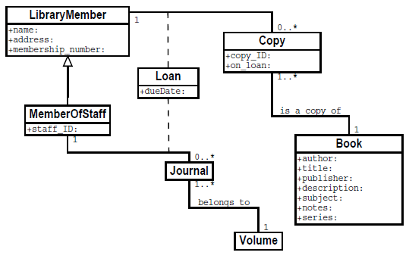
Updated Class Diagram

Slide 20
Discovering Responsibilities
• Now we need to think about what behaviors or responsibilities each class should have
i.e. these will become methods in our classes
• Think about which class(es) should be responsible for preforming the necessary tasks

Slide 21
Use Javadoc to document method behavior
public class LibraryMember {
private int mMemberShipNumber;
private String mName;
private String mAddress;
// implements the association with Copy
private Collection mBorrowedBooks;
/**
* Records the loan of a book against this LibraryMember
* (Postcondition: hasBook(copyToBorrow) == true;
* the Loan is recorded)
* @param copyToBorrow a copy of the book to borrow
* @param dueDate the due date of the book
* (Precondition: dueDate > today’s date)
*/
public void borrowBook(Copy copyToBorrow, Date dueDate){ }

Slide 22
Use Javadoc to document method behavior
/**
* Checks to see if there are overdue books
* for this library member
* @return a collection of Copy objects -
* an empty collection indicates that there are
* no overdue books for this library member
*/
public Collection checkOverdue() { }
. . .

Slide 23
OO Design Summary
1. Gather and organize requirements
2. Use noun analysis to find classes
3. Use verb analysis to find associations and functionality
4. Use UML class diagrams to record class relationships
5. Use javadoc to document method behavior
6. Implement your program

Slide 24
Credits
COMP209
Object Oriented Programming
System Design 2
Mark Hall

